Slide 1
Survey
SKYPE SURVEY
What’s your experience with NLP?
Very little – I don’t know what NLP really is
Little
Moderate
High
Very high – I am a skilled NLP programmer
SKYPE SURVEY

Slide 2

Intro to
Natural Language Processing
Sunny Song, Divya UK
September 5, 2018

Slide 3



Introduction
Moderator:
Sunny Song
Apps Services
North America
Speaker:
Divya UK
Data Science and Analytics
India
Speaker:
Kirtyanand Mishra
Data Science and Analytics
India

Slide 4
Agenda
Topic approx. time
Introduction to NLP 20 min.
NLP Use Cases 10 min.
Anaconda and Jupyter Notebook Setup 10 min.
Learn about Natural Language Processing, the foundation behind Siri, Google Duplex, and Amazon Alexa, and the way’s Capgemini has leveraged NLP for it’s clients. These are accompanied by hands on exercises in Python and a demo on IBM Watson
This material was put together by Divya UK, Brian Halperin, and Sunny Song specifically for Global Innovators Month.

Slide 5
Chapter 1: Introduction to NLP

Slide 6

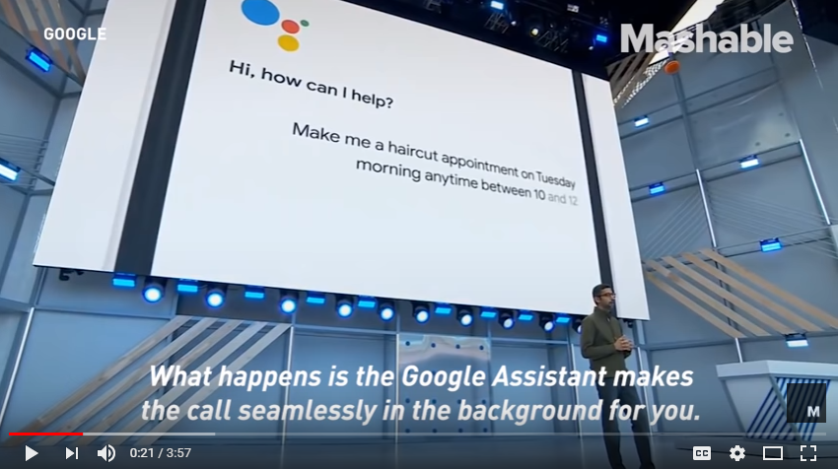
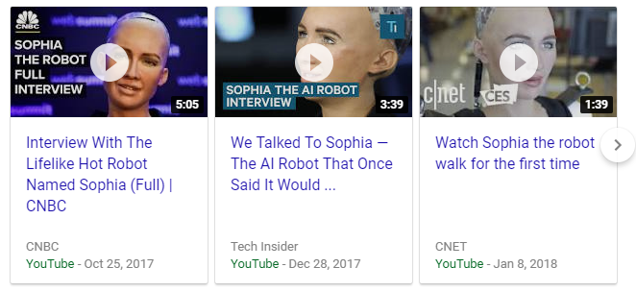
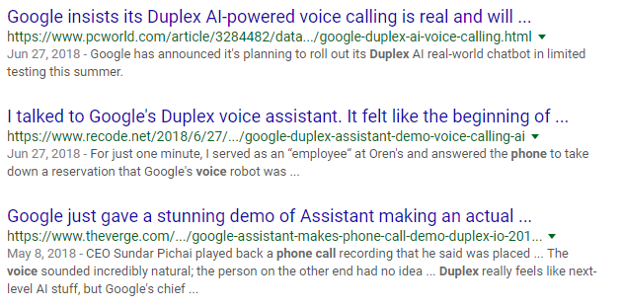
Popular Examples of NLP
Sofia, Hanson Robotics
Duplex, Google

Slide 7
Activity
Jane hit June and then she fell.

Slide 8
Survey
SKYPE VOTING
Who is “She”? (“Jane hit June and then she fell.”)
Jane
June
Unsure
SKYPE VOTING

Slide 9

Natural Language
Natural language refers to the way we humans communicate to each other namely speech and text
Challenges
Ambiguity – Same words have multiple meanings
The words like Apple, Amazon, Jaguar
Synonyms – Many words describe the same thing
Cab, taxi… holiday, vacation

Slide 10


General Problem with Data
Sensor 1
Non-Text Data Numeric, Categorical, Relational, Video
Sensor 2
Sensor n
NLP
Processing
Text Data

Slide 11
What is NLP
Computer Science
Linguistics
Artificial
Intelligence
Natural Language Processing (NLP) is the ability of machines to understand and interpret human language the way it is written or spoken.
The objective of NLP is to make computer/machines as intelligent as human beings in understanding language.

Slide 12
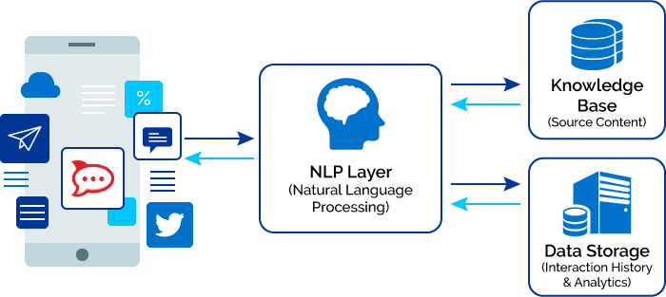
What is NLP
According to industry estimates, only 21% of the available data is present in structured form

Slide 13
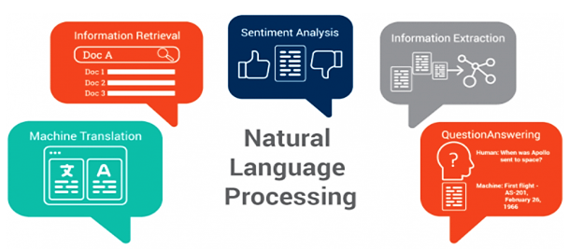



Applications of NLP
Common Applications
Spell Check Functionality-MS Word
Spam Filters- Email
Search Engines

Slide 14
Chapter 1: Introduction to NLP Important Tasks

Slide 15
Important tasks of NLP
This section talks about different use cases and problems in the field of natural language processing:
Task
Classification
Text Matching and Similarity

Slide 16
Text Classification
Text Classification
Text classification is one of the classical problem of NLP.
Notorious examples include: Email Spam Identification, topic classification of news, sentiment classification and organization of web pages by search engines.
Text classification, in common words is defined as a technique to systematically classify a text object (document or sentence) in one of the fixed category. It is really helpful when the amount of data is large, especially for organizing, information filtering, and storage purposes.
A typical natural language classifier consists of two parts: (a) Training, (b) Prediction.
Firstly the text input is processes and features are created. The machine learning models then learn these features and is used for predicting against the new text.
The text classification model are heavily dependent upon the quality and quantity of features, while applying any machine learning model it is always a good practice to include more and more training data.

Slide 17
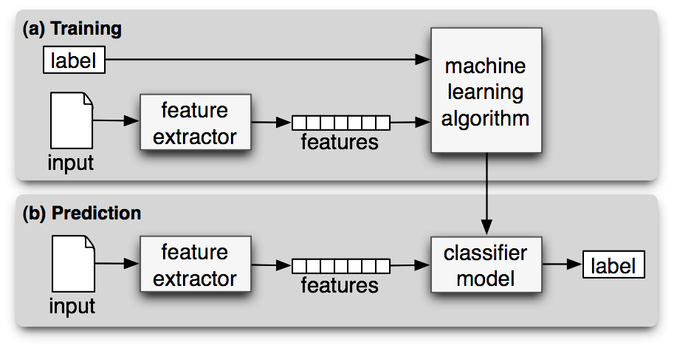
Text Classification Visualized

Slide 18
Text Matching and Similarity
Text Matching and Similarity
One of the important areas of NLP is the matching of text objects to find similarities.
Important applications of text matching includes automatic spelling correction, data de-duplication and genome analysis etc.
A number of text matching techniques are available depending upon the requirement, we will discuss the most common and advantageous one: Cosine Similarity
When the text is represented as vector notation, a general cosine similarity can also be applied in order to measure vectorized similarity

Slide 19
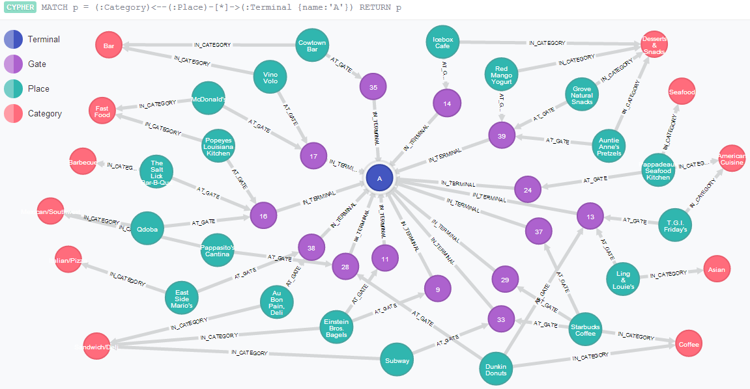
Text Matching Similarity Visualized

Slide 20
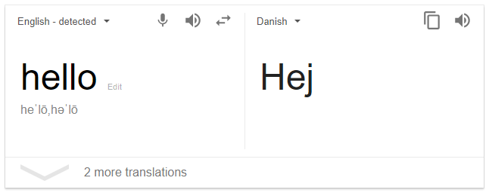
Additional NLP Problems/Tasks
Machine Translation
Automatically translate text from one human language to another by taking care of grammar, semantics and information about the real world, etc.

Slide 21
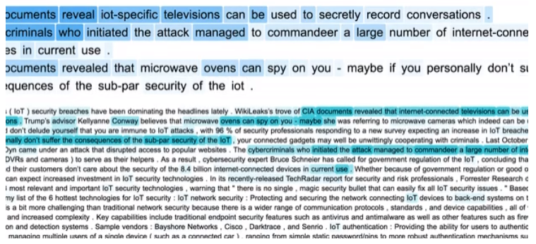
Additional NLP Problems/Tasks
Text Summarization
Given a text article or paragraph, summarize it automatically to produce most important and relevant sentences in order.

Slide 22
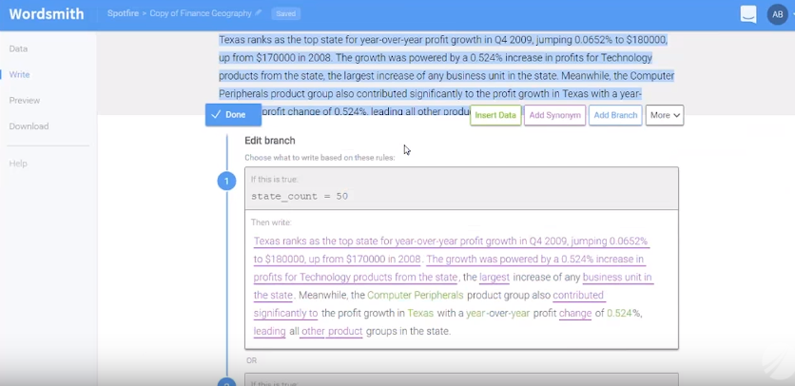
Additional NLP Problems/Tasks
Natural Language Generation & Understanding
Convert information from computer databases or semantic intents into readable human language is called language generation. Converting chunks of text into more logical structures that are easier for computer programs to manipulate is called language understanding.

Slide 23
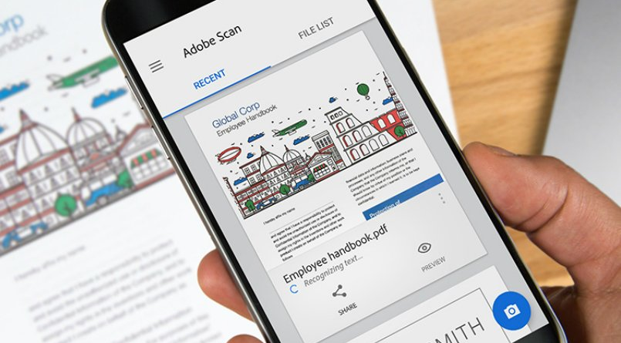
Additional NLP Problems/Tasks
Optical Character Recognition
Given an image representing printed text, determine the corresponding text.

Slide 24
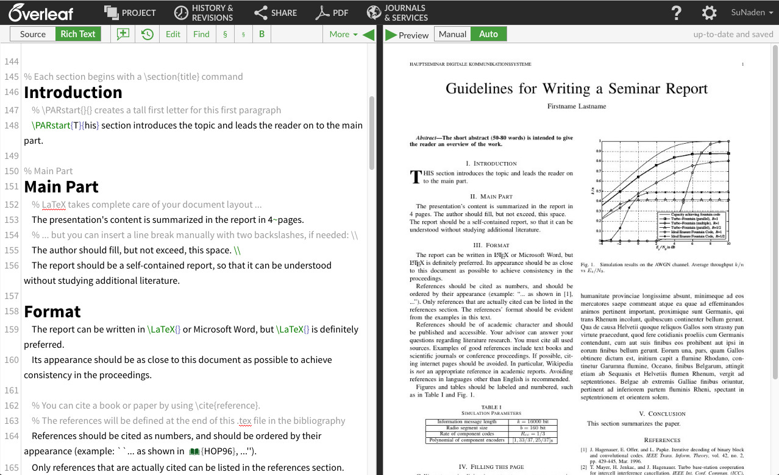
Additional NLP Problems/Tasks
Document to Information
This involves parsing of textual data present in documents (websites, files, pdfs and images) to analyzable and clean format.

Slide 25
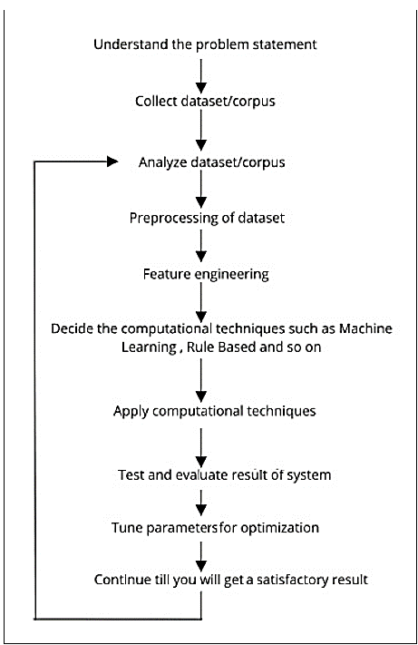
Development Life Cycle
Feature engineering is the process of generating or deriving features (attributes or an individual measurable property) from raw data or corpus that will help us develop NLP applications or solve NLP-related problems

Slide 26
Survey
SKYPE POLL
Which of the following voicebots have you used? (multiple selection)
Apple Siri
Google Home
Amazon Alexa
Other
None
SKYPE POLL

Slide 27
Chapter 2: Use Cases

Slide 28
Chapter 2: Use Cases Automatic Ticket Categorization for an IT & Networking Major

Slide 29

Overview
Case Study #1: Automatic Ticket Categorization for an IT & Networking Major
Client has a huge portfolio of products which are supported internally/ by vendors
Hundreds of tickets against issues faced are reported each day
These tickets are then manually categorized by the support personnel
Client wants to automate the process of ticket categorization to help reduce the downtime and improve ticket resolution time

Slide 30
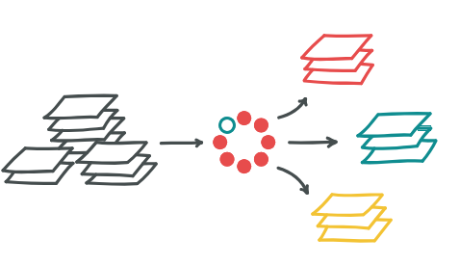
Challenge/Issues
Case Study #1: Automatic Ticket Categorization for an IT & Networking Major
Client wants to build an application which automatically categorizes incoming tickets into predefined operational/resolution codes
The classification accuracy should be consistently high
The algorithms/models used should be able to learn based on new tickets and also through the feedback provided by the human agents
For non-repetitive tickets, the system should recommend service/resolution codes to the human agents

Slide 31
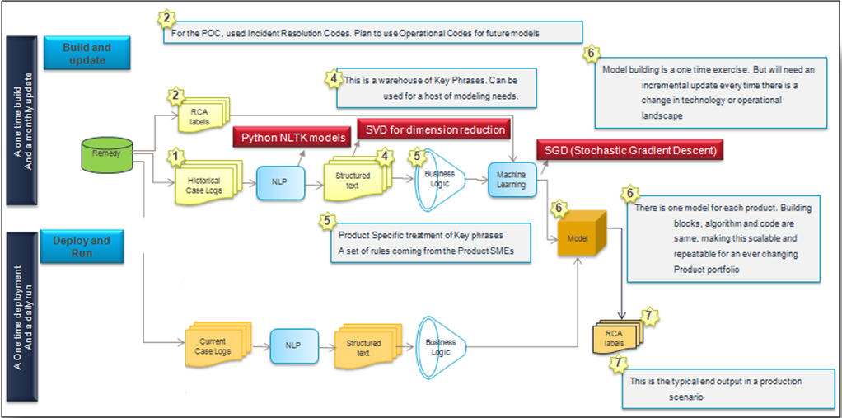
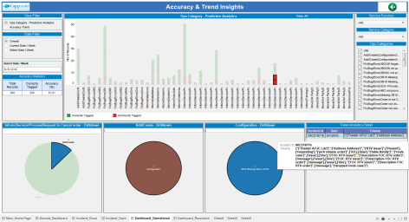
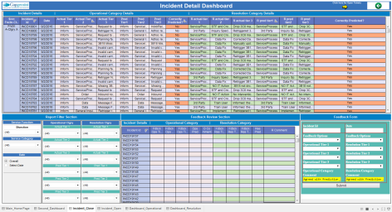
Solution
Case Study #1: Automatic Ticket Categorization for an IT & Networking Major
Capgemini built a solution involving SVD and SVM to automatically categorize tickets
Ticket description is cleaned and analyzed for patterns
SVD reduces large number of textual “features” into a smaller number while preserving the information conveyed
The statistical algorithm (SVM) is trained on these patterns to make service/resolution code recommendations
Feedback mechanism is incorporated for improving accuracy
Interface for accuracy assessment
Interface to visualize the tickets
Solution Architecture
Tools
Algorithm Development – Python
Algorithm Used – Singular Value Decomposition, Support Vector Machine

Slide 32
Benefits
Case Study #1: Automatic Ticket Categorization for an IT & Networking Major
Automation of incident categorization
Faster resolution of incidents based on the identified service/resolution category
Visual analysis of the accuracy to help take corrective actions
Objective ticket resolution identification based on textual information
Reduction in costs incurred due to longer downtime
Higher efficiency achieved
Interface for accuracy assessment
Interface to visualize the tickets
Solution Architecture
Algorithm Development – Python
Algorithm Used – Singular Value Decomposition, Support Vector Machine

Slide 33
Chapter 2: Use Cases Talent to Brand Matching

Slide 34
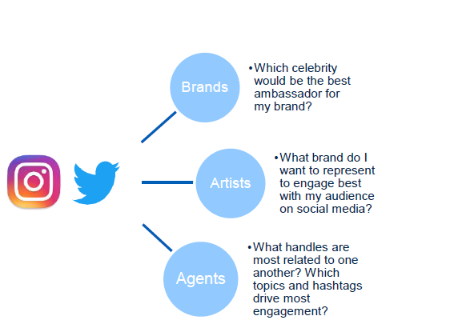
Overview
Case Study #2: Talent to Brand matching for Advertising Agency
Client wanted to make an intelligent decision in order to match brands to talents for their advertising campaigns and vice versa
They wanted to use social media and other internal data sources to make better, more profitable matches between celebrities and brands
Understand which brand is similar to which talents on social media and leverage synergies

Slide 35
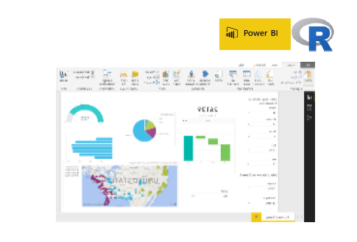
Solution
Capgemini built a solution involving
Extracted data from social media –all content and reactions from Twitter and Instagram
Apply NLP techniques to clean data and extract meaning from data
Word cleaning, stemming , stopword removal , replacing emojis with meaningful phrases
Extract hashtags (#) and handles (@) and distinguish them from other words
Use topic modelling and sentiment analysis to understand what brands and talents talk about and how they engage with their audience – uncover closest “brand-talent” pairs
Created Power BI tool to easily visualize data and take action
Tools
Algorithm Development – R
Visualization – Power BI

Slide 36
Benefits
Case Study #2: Talent to Brand matching for Advertising Agency
Social media data to make better decisions in brand to talent matching
Better understanding of artists’ and brands’ audience on social media
Power BI to drive quick insights
Tools
Algorithm Development – R
Visualization – Power BI

Slide 37
Chapter 3: How to Setup Anaconda and Jupyter Notebook on Windows PCs

Slide 38

These slides will show you how to install and set up the software for the Data Science Curriculum for Global Innovators Month 2018

Slide 39
Chapter 3: Software Setup How to Setup Anaconda

Slide 40
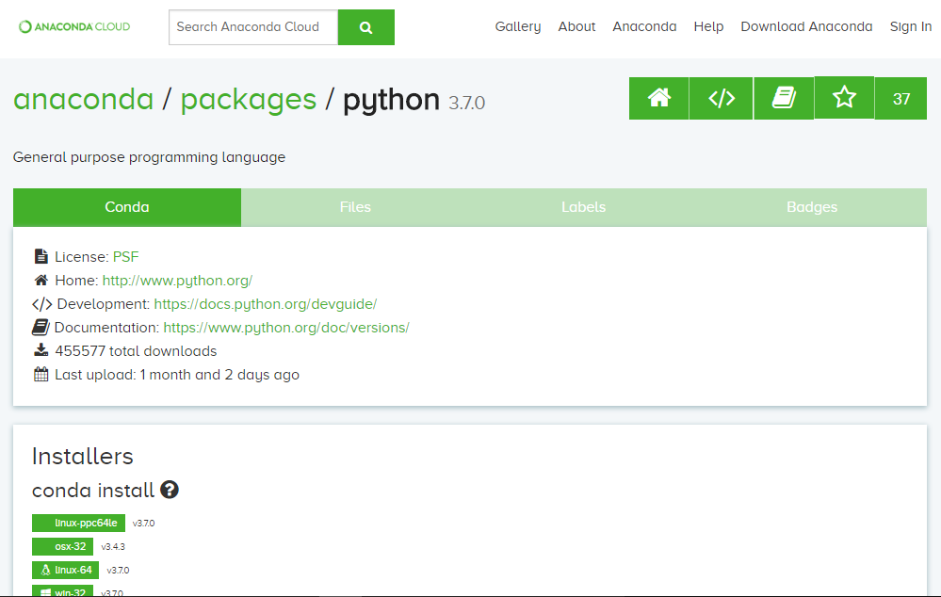
What is Anaconda
Anaconda is a freemium open source distribution of the Python and R programming languages for large-scale data processing, predictive analytics, and scientific computing, that aims to simplify package management and deployment. Package versions are managed by the package management system conda.
We can use it, even if we have already installed Python.
One advantage is the possibility to create separate environments. These are some kind of sandboxes, that don‘t affect already existing Python installations or other environments.

Slide 41
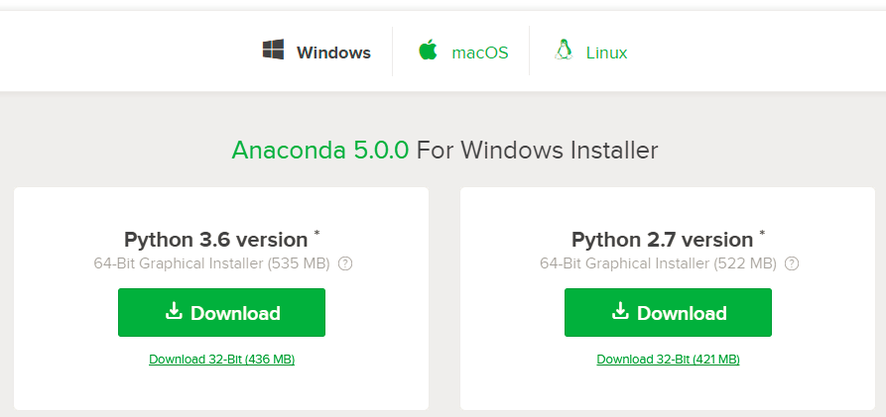
Where to find Anaconda
www.anaconda.com/download
We will use version 3.6 in this course

Slide 42
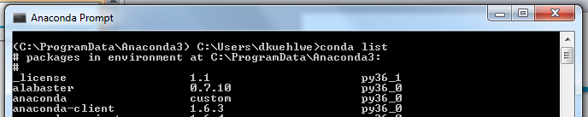
Installing the Necessary Packages
Copy the file requirements.txt from the preparation e-mail in your working directory and type “conda install --yes --file requirements.txt” in the Anaconda prompt to install all packages that we’ll use during the training.
In order to list the packages which are already installed in your environment, start the Anaconda Prompt and type “conda list”
You can also use conda to install additional packages (e.g. numpy, pandas, matplotlib) via conda install numpy, conda install pandas, conda install matplotlib

Slide 43
Chapter 3: Software Setup How to Setup Jupyter Notebook

Slide 44

Using Jupyter Notebook
The Jupyter Notebook is an open-source web application that allows you to create and share documents that contain live code, equations, visualizations and explanatory text. Uses include: data cleaning and transformation, numerical simulation, statistical modeling, machine learning and much more.
In industry, the Jupyter Notebook is widely used as a daily computation and data-analysis tool, and major companies have created hosted services based on Jupyter.
In education, at least 45 different courses use Jupyter Notebooks to teach a wide variety of subjects, including high-school level Computer Science, Aerodynamics, Numerical Methods, Statistics, Computational Physics, Cognitive Science and Data Science.

Slide 45
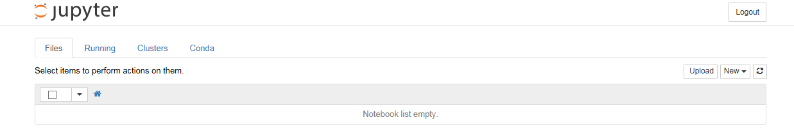
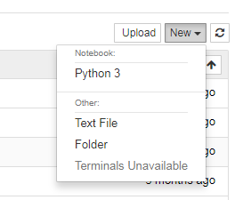
Where to find Anaconda
http://jupyter.org/install
After starting jupyter in the command prompt, your browser should show you
Create a new notebook by clicking new

Slide 46
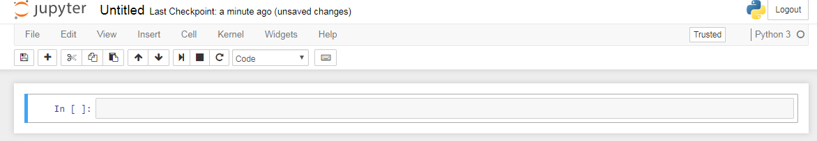
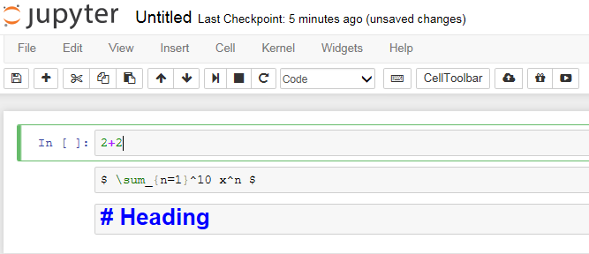
Where to find Anaconda
http://jupyter.org/install
The new notebook will start with an empty cell
You can fill cells in code mode or in markdown mode

Slide 47
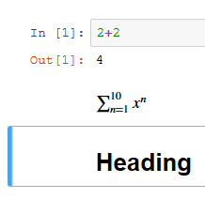
Where to find Anaconda
http://jupyter.org/install
Hit CTRL + ENTER to
evaluate the individual cells:

Slide 48
New Environments and Packages
If this is the first Python installation on your machine, ignore this slide
If you already have a version of Python installed, you might want to create a new conda environment.
Create new aconda environment via conda create –n myenv python=3
The new environment‘s name is „myenv“. If you want to use Python 2.7 type: conda create –n myenv python=2
Using environments has the benefit, that neither the existing Python installation nor other environments
are affected.
Activate or deactivate the environment with:
Windows: activate myenv or deactivate myenv
Linux source activate myenv source deactivate myenv
You can find out which environments are installed on your computer, by typing: conda env list

Slide 49
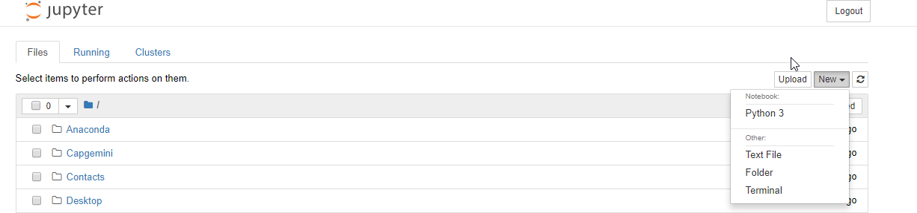
Uploading Data and Files
We need to create a new folder for the datasets we will be using for the notebooks
Once you create a new folder, it should be called “Untitled Folder”. You can rename it to whatever you like.

Slide 50
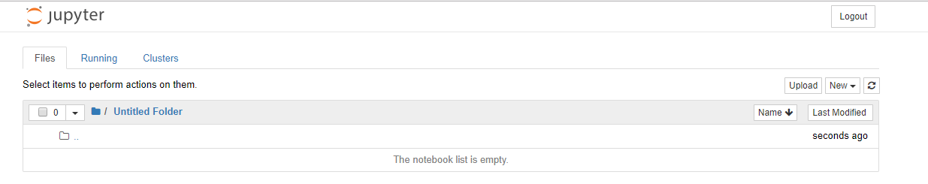
Uploading Data and Files
Use the upload button to upload all the data files we will be using.
Upload all .CSV + .Ipynb files to the folder

Slide 51
Questions?

Slide 52
Next Week’s
Session
NLP Technical Workshop
This is interactive technical workshop that will teach you to apply NLP concepts to datasets.
Notes:
Fixar a posicao do titulo – sempre do lado esquerdo.
Sempre que tiver muito texto o coluna deve sempre ser “ narrowed” , se nao fica dificil de ler. Colocar paragrafos no texto.
Linha vertical deve ser mais fina e as pontas NUNCA devem ser arredondadas.

Slide 53



- End of Presentation -
Thank you

